Slide 1
Introduction to Connectivity: PPI and SEM
Methods for Dummies 2011/12
Emma Jayne Kilford & Peter Smittenaar

Slide 2
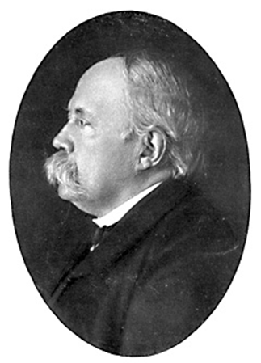
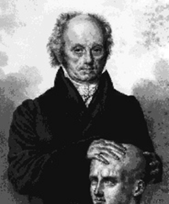
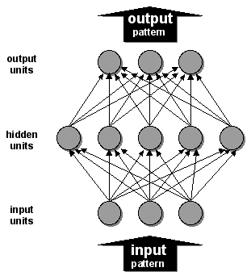
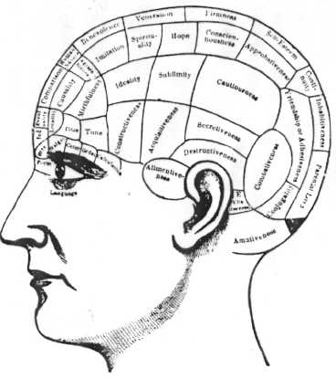
Background
Localizationism
Functions are localized
in anatomic cortical regions
Damage to a region results
in loss of function
Key 19th Century proponents:
Gall, Spurzheim
Globalism
The brain works as a whole,
extent of brain damage is
more important than its
location
Key 19th Century proponents:
Flourens, Goltz
History:
Functional Segregation
Functions are caried out by
specific areas/cells in the
cortex that can be anatomically
separated
Connectionism
Networks link different
specialised areas/cells
Functional Specialisation
Different areas of the brain are specialised for different functions
Functional Integration
Networks of interactions among specialised areas

Slide 3
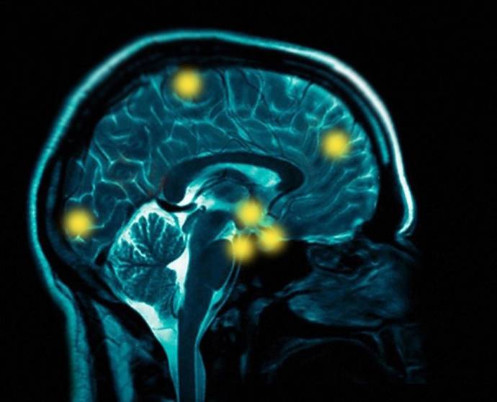
How to study…
Goal: Where are regional responses to experimental manipulation?
Method: Univariate analyses of regionally specific effects
E.g: Lesion studies, conventional SPM analyses.
Functional Specialisation
Specialised areas exist in the cortex
Functional Integration
Networks of interactions among specialised areas
Goals:
- How does one region influence another (coupling)?
- How is coupling affected by experimental manipulation?
Method: Multivariate analyses of regional interactions
1
2

Slide 4
Measures of Functional Integration
Functional integration can be further subdivided into:
Functional connectivity observational approach
Simple temporal correlation between activation of remote neural areas
Cannot explain how the correlations in activity are mediated
Effective connectivity model-based approach
The influence that one neuronal system exerts over another (Friston et al., 1997)
Attempts to disambiguate correlations of a spurious sort from those mediated by direct or indirect neuronal interactions
Types of analysis to assess effective connectivity:
PPIs - Psycho-Physiological Interactions
SEM - Structural Equation Modelling
DCM - Dynamic Causal Modelling
Static Models
Dynamic Model

Slide 5
Psycho-physiological Interactions (PPIs)
Measure effective connectivity, and how it is affected by psychological variables.
Key Question: How can brain activity be explained by the interaction between psychological and physiological variables?
e.g. How can brain activity in V5 be explained by the interaction between attention and V1 activity?
This is done voxel-by-voxel across the entire brain.

Slide 6
PPIs vs Typical Interactions
A typical interaction: How can brain activity be explained by the interaction between 2 experimental variables?
Y = (T₁-T₂) β₁ + (S₁-S₂) β₂ + (T₁-T₂)(S₁-S₂) β₃ + e
Interaction term
= the effect of Motion vs.
No Motion under Attention vs. No Attention
E.g.
Task
1. Attention
2. No Att
Motion
T₁ S₁
T₂ S₁
1. Motion
Stimulus
T₁ S₂
T₂ S₂
2. No Motion
No Motion
Att
No Att
Load

Slide 7
PPIs vs Typical Interactions
A PPI: Replace one of the exp. variables with activity
in a source region (associated with a main effect of the
exp. variable in the typical interaction.)
e.g. For source region V1 (Visual Cortex Area 1)
Y = (Att-NoAtt) β₁ + V1 β₂ + (Att-NoAtt) * V1 β₃ + e
Interaction term
= the effect of attention vs no attention and V1 activity on V5 activity
Psychological Variable:
Attention – No attention
Physiological Variable:
V1 Activity
Attention
Test the null hypothesis that the interaction term does not contribute significantly to the model:
H₀: β₃ = 0
Alternative hypothesis:
H₁: β₃ ≠ 0
V5
activity
No Attention
V1 activity

Slide 8
Interpreting PPIs
2 possible ways:
1. The contribution of the source area to the target area response depends on experimental context
e.g. V1 input to V5 is modulated by attention
2. Target area response (e.g. V5) to experimental variable (attention) depends on activity of source area (e.g. V1)
e.g. The effect of attention on V5 is modulated by V1 input
attention
1.
V1
V5
V1
attention
2.
Mathematically, both are equivalent, but one may be more neurologically plausible
V1
V5
V1

Slide 9
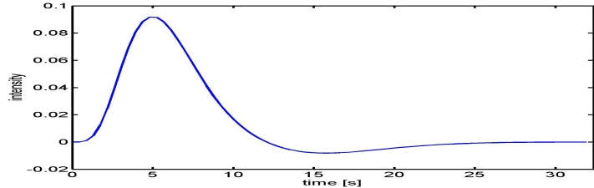
Where do interactions occur? Hemodynamic vs neural level
- We assume BOLD signal reflects underlying neural activity convolved with HRF:
HRF basic function
- But interactions occur at NEURAL LEVEL
And (HRF x V1) X (HRF x Att) ≠ HRF x (V1 x Att)

Slide 10
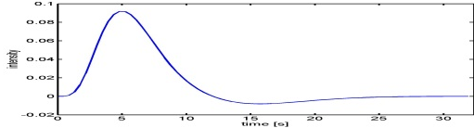
Where do interactions occur? Hemodynamic vs neural level
SOLUTION:
1- Deconvolve BOLD signal corresponding to region of interest (e.g. V1)
2- Calculate interaction term considering neural activity
psychological condition x neural activity
3- Re-convolve the interaction term using the HRF
BOLD signal in V1
Neural activity in V1
Psychological variable
x
HRF basic function
Neural activity in V1 with
Psychological Variable reconvolved
Gitelman et al. Neuroimage 2003

Slide 11
PPIs in SPM
Perform Standard GLM Analysis with 2 experimental factors
Extract time series of BOLD SIGNAL from source region (e.g. V1)
- The regressor value for the source region needs to be one value
However the source region will be made up of more than 1 voxel
Use Eigenvalues (there is a button in SPM) to create a summary value of the activation across the region over time.
3. Form the Interaction term
1. Select (from the previous equation-matrix) those parameters we are interested i.e.
- Psychological condition: Attention vs. No attention
- Activity in V1
2. Deconvolve physiological regressor (V1)→ transform BOLD signal into electrical activity

Slide 12
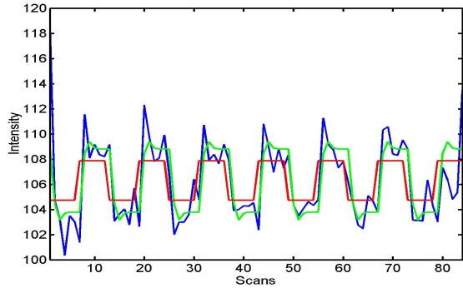


PPIs in SPM
3. Calculate the interaction term V1x (Att-NoAtt)
4. Convolve the interaction term V1x (Att-NoAtt)
4. Put the Interaction term into a 2nd GLM Analysis
1. Put into the model this convolved term:
Y = (Att-NoAtt) β₁ + V1 β₂ + (Att-NoAtt) * V1 β₃ + β_{i}Xi + e
H₀: β₃ = 0
2. Create a t-contrast [0 0 1 0] to test H₀
Electrical activity
HRF basic function
BOLD signal

Slide 13
Pros and Cons of PPI Approach
Pros
Can look at the connectivity of the source area to the entire brain, and how it interacts with the experimental variable (e.g. attentional state)
Cons
Can only look at a single source area
Not easy with event-related data
Limited in the extent to which you can infer a causal relationship

Slide 14
PPI References
D.R. Gitelman, W.D. Penny, J. Ashburner, and K.J. Friston. (2003). Modeling regional and psychophysiologic interactions in fMRI: the importance of hemodynamic deconvolution. NeuroImage, 19:200-207.
K.J. Friston, C. Buchel, G.R. Fink, J. Morris, E. Rolls, and R. Dolan. Psychophysiological and modulatory interactions in Neuroimaging. (1997). NeuroImage, 6:218-229, 1997.
SPM Dataset – Psycho-Physiologic Interaction: http://www.fil.ion.ucl.ac.uk/spm/data/attention/
Descriptions of how to do General Linear Model (GLM) and (Psycho-Physiologic Interaction) PPI analyses using SPM5/8 are in the SPM manual.
Overview of the dataset, and step-by-step description of analysis using PPI in chapter 33 of the SPM8 manual.

Slide 15
Structural equation modeling

Slide 16
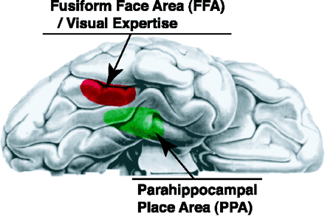
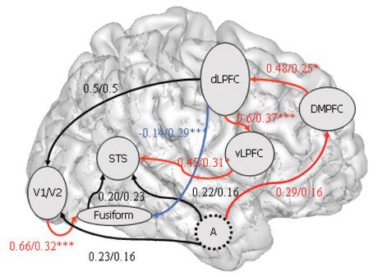
Recap
Functional specialisation vs functional integration
r
r
functional connectivity
nothing more than a correlation
could be anything (third driving region, effective connectivity, …)
effective connectivity
explains the correlation by describing a uni- or bi-directional causal effect

Slide 17
SEM & fMRI
functional
connectivity
hypothesis-free
correlations (e.g. classic resting-state)
Psychophysiological interactions
Physiophysiological interactions
Structural equation modeling
Dynamic causal modeling
effective
connectivity
hypothesis-driven

Slide 18
Structural equation modeling
Origin: S. Wright in 1920
General tool to estimate causal relations based on
statistical data
assumptions about causality
Can be used both exploratory and confirmatory
Commonly used in many fields (e.g. economics, psychology, sociology)
2005-2010: equal number of DCM as SEM fMRI papers

Slide 19
When do you use SEM?
Study multiple causality (i.e. multiple regions and pathways simultaneously)
knowledge of underlying anatomy
anatomical information
covariance data
effective connectivity

Slide 20
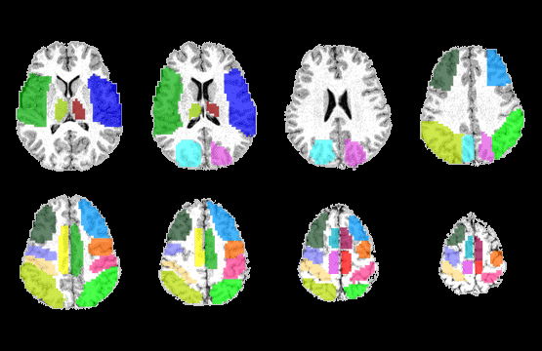

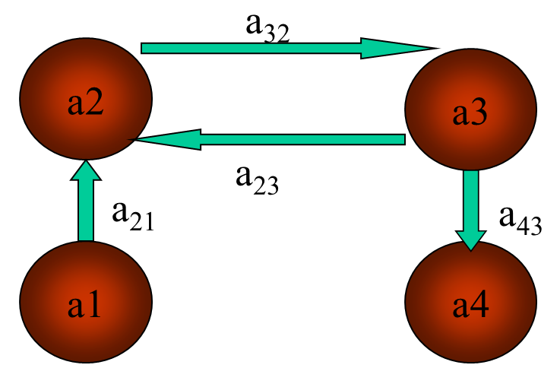
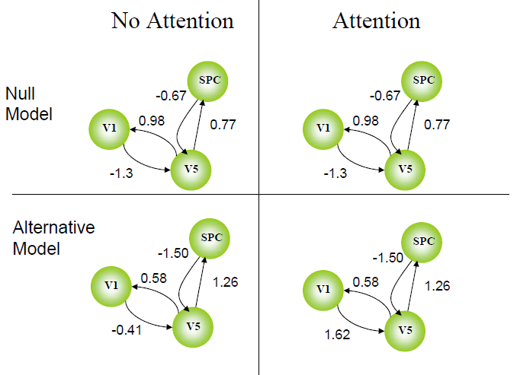
SEM workflow
Select ROIs
calculate sample covariance
decide on pathways
inference
estimate effective model

Slide 21
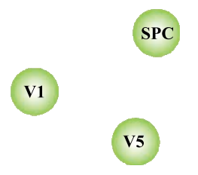
Select ROIs
Select ROIs
Sample covariance
Set pathways
Estimate
Inference
Based on experimental question
defined functionally via GLM or anatomically
Include regions for which you have some evidence of connectivity

Slide 22
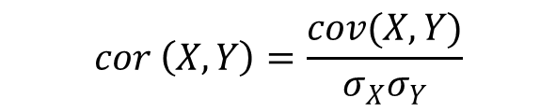
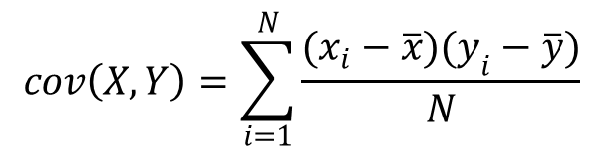
Sample covariance
Select ROIs
Sample covariance
Set pathways
Estimate
Inference
Covariance tells us to what extent regions are correlated, and is same thing as correlation when working with z-scored values:
$$cov\left(X,Y\right)=\sum_{i=1}^{N}{\frac{(x_{i}−\overline{x})(y_{i}−\overline{y})}{N}}$$
$$cor \left(X, Y\right)=\frac{cov(X,Y)}{σ_{X}σ_{Y}}$$
 | 0.58 | 0.99 | -0.02
 | 0.99 | 2.36 | -0.03
 | -0.02 | -0.03 | 1.11
covariance
 | 1.00 | 0.84 | -0.02
 | 0.84 | 1.00 | -0.02
 | -0.02 | -0.02 | 1.00
correlation

Slide 23
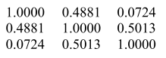
Sample covariance
Select ROIs
Sample covariance
Set pathways
Estimate
Inference
high covariance might indicate strong influence of regions over each other, but doesn’t tell you which direction!
This is functional connectivity
However, SEM takes it one step further and models the covariances based on anatomical priors
This will give us directionality and causality (effective connectivity)
v1 v5 SPC
v1
v5
SPC

Slide 24
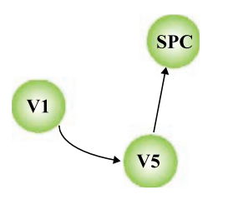
Set pathways
Select ROIs
Sample covariance
Set pathways
Estimate
Inference
By specifying pathways we can go from correlation to causation (effective connectivity)
degrees of freedom determines max number of pathways (i.e. can’t just put in all pathways)
dof = n(n+1)/2 n = number of regions
= 6 for this example
You need 1 for each region’s unique variance, so 3 remain for drawing connections

Slide 25
SEM workflow
Select ROIs
calculate sample covariance
decide on pathways
inference
estimate effective model

Slide 26
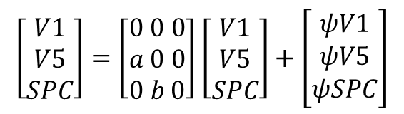
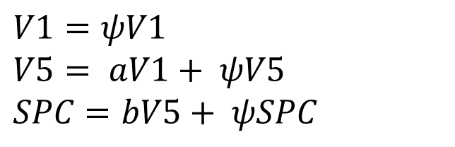
Estimate
Select ROIs
Sample covariance
Set pathways
Estimate
Inference
Variance in each area modelled as
unique variance in that region (ψ)
shared variance with other regions (a and b)
$$\left[\begin{aligned}V1 \\ V5 \\ SPC\end{aligned}\right]=\left[\begin{aligned}0 0 0 \\ a 0 0 \\ 0 b 0\end{aligned}\right]\left[\begin{aligned}V1 \\ V5 \\ SPC\end{aligned}\right]+\left[\begin{aligned}ψV1 \\ ψV5 \\ ψSPC\end{aligned}\right]$$
b
a
Structural equations:
$$V1=ψV1$$
$$V5= aV1+ ψV5$$
$$SPC=bV5+ ψSPC$$

Slide 27
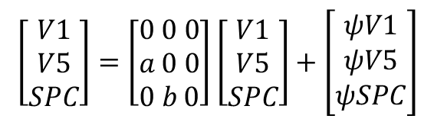
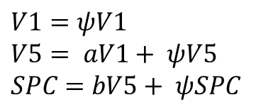
Estimate
Select ROIs
Sample covariance
Set pathways
Estimate
Inference
path strengths (a, b)
modelled covariance
matrix
sample covariance matrix
match with
Optimisation procedure
Pick two values for a and b
Calculate modelled timecourses in V1, V5 and SPC
calculate what covariance matrix this would give you
see how closely it matches the sample covariance
slightly adjust a and b to match sample and model covariance
End up with a and b that best explain the observed covariances
b
a
$$\left[\begin{aligned}V1 \\ V5 \\ SPC\end{aligned}\right]=\left[\begin{aligned}0 0 0 \\ a 0 0 \\ 0 b 0\end{aligned}\right]\left[\begin{aligned}V1 \\ V5 \\ SPC\end{aligned}\right]+\left[\begin{aligned}ψV1 \\ ψV5 \\ ψSPC\end{aligned}\right]$$
$$V1=ψV1$$
$$V5= aV1+ ψV5$$
$$SPC=bV5+ ψSPC$$

Slide 28
SEM workflow
Select ROIs
calculate sample covariance
decide on pathways
inference
estimate effective model

Slide 29
Inference
Select ROIs
Sample covariance
Set pathways
Estimate
Inference
Question:
Is V1-V5 connectivity modulated by attention?
Stacked-model approach:
split your BOLD signal into parts ‘attention’ and ‘no-attention’ and calculate sample covariance
H₀: path strengths equal between conditions
H₁: V1-V5 path strength allowed to vary between conditions
Fit both and see if H₁ fits data significantly better
Measure of fit is chi-square: the lower χ² the more similar the modelled covariance to the sample, i.e. the better the fit
b
a

Slide 30
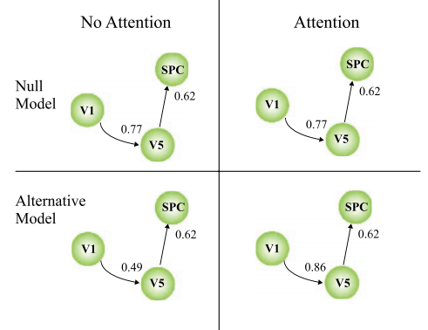
Inference
Select ROIs
Sample covariance
Set pathways
Estimate
Inference
χ² = 33.2
dof = 4
χ² = 24.6
dof = 3
Alternative significantly
better:
χ² = (33.2 – 24.6) = 8.6
dof = 4-3 = 1
p = .003

Slide 31
SEM workflow
Select ROIs
calculate sample covariance
decide on pathways
inference
estimate effective model

Slide 32
 | SEM | PPI
Connectivity | Effective | Effective
What is it? | Estimation of causal influence of multiple areas on each other, using a priori anatomical information and covariance data | ‘model-free’: examine influence of 1 ROI on any other part of the brain as function of psychological context
Input | Covariance data for >2 ROIs, limited number of paths between ROIs | Timecourses for ROIs + psychological variable
Outcome | Path strengths model fits | Beta coefficient for interaction at every voxel in the brain
Strength | Multiple areas: multiple causality Incorporates anatomical data | Model- and assumption-free Easy to implement
Weakness | Can only use nested models Does not account for inputs (static) | Max 2 areas at the same time static

Slide 33
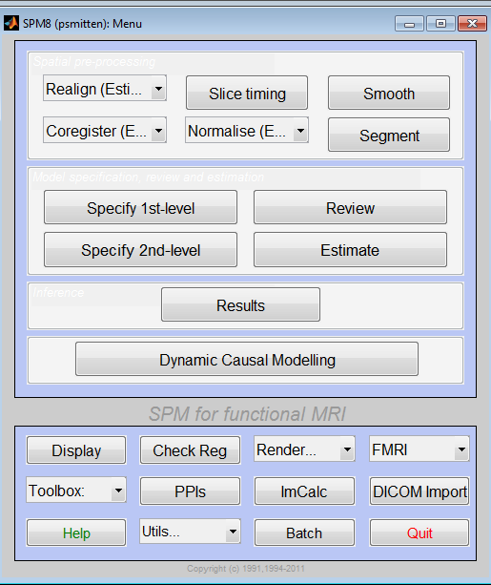
SEM in SPM
… is not there
Toolbox available
http://www.dundee.ac.uk/medschool/staff/douglas-steele/structural-equation-modelling/

Slide 34
Takehome
Functional specialisation vs integration
Functional vs effective connectivity
PPI — static; effective connectivity between 2 regions in psychological context
SEM — static; effective connectivity, many regions at once
DCM — dynamic; effective connectivity, many regions, at neural level, can handle inputs

Slide 35

References
Penny et al (2004) — comparison of SEM and DCM
McIntosh (1994) — great introduction to SEM
Previous years’ slides
Fletcher (2003) — slides on PPI, SEM, connectivity
Many thanks to Rosalyn Moran

Slide 36
extra slides

Slide 37
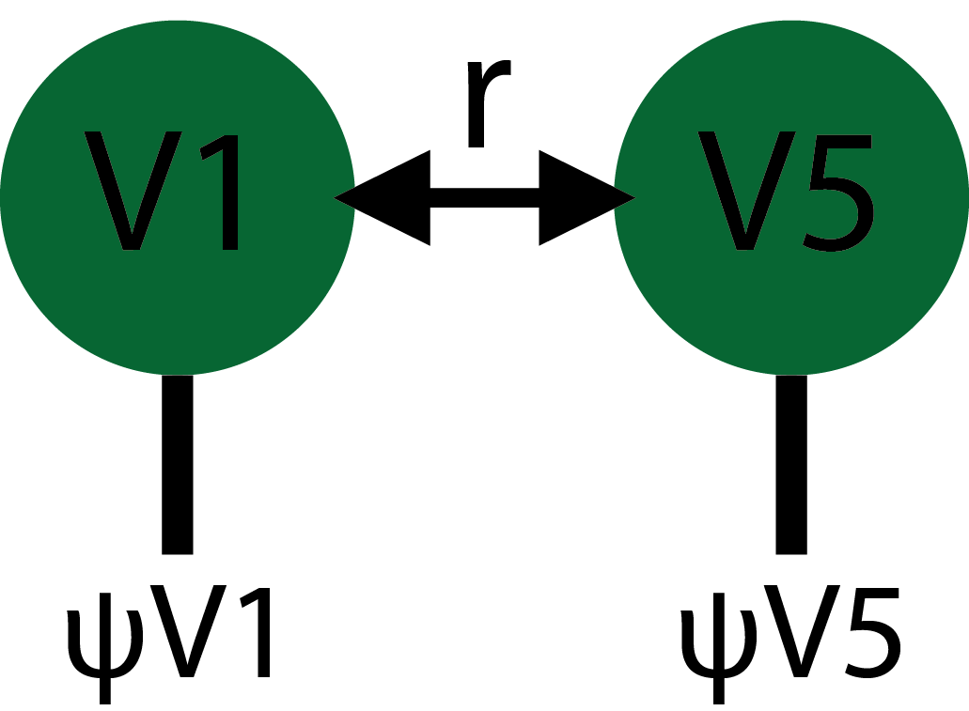
How can SEM infer causality if it only looks at instantaneous correlations?
This works because you have more knowns than unknowns, e.g. 5 structural equations for 4 parameters to be estimated
To confirm your intuition: SEM doesn’t give you directionality if you only have 2 areas!
You’d have 2(2+1)/2 = 3 degrees of freedom
2 for the unique variance in each area
1 for the shared variance
But 1 is not enough: you wouldn’t know which way to draw the arrow!

Slide 38
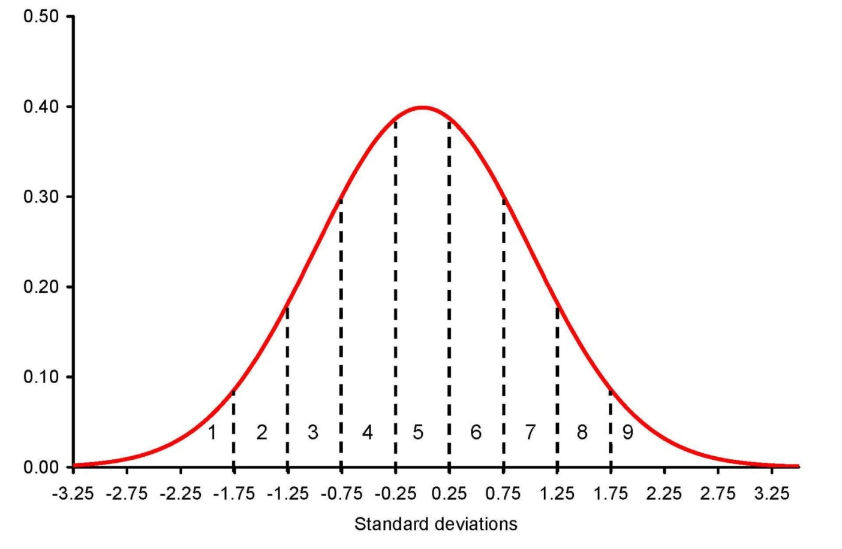
z-scores
z = (y_{t} – mean_{y})/std_{y}
Every datapoint expressed as signed standard deviations from the mean
After z-scoring data, mean = 0, std = 1.

